Slide 1
MIU TUTORING PLATFORM
SRS and Design Presentation
GitHub url: https://github.com/MIU-CS425-Project/miu-tutoring-platform
Team Members:
Kirubel Andargie
Mickias Mekonnen
Mikyas Belhu
Negede Teshome

Slide 2
INTRODUCTION
PROBLEM STATEMENT
Due to the unfortunate pandemic the world is in right now, the education system here in MIU and all over the world has seen a shift from a classroom session to online platforms where students can still follow their classes while maintaining the safety guidelines suggested by health officials. This has created a big gap in how students INTERACT with each other and LEARN from one another.
The MIU student tutoring web app will be the platform where:
Tutees can get assistance with coursework
Faculty can assist and keep track of Student’s progress
Outstanding Tutors and Tutees are recognized
A platform to learn extracurricular activities Provides an opportunity for students to study together in an online platform that alleviates current circumstances caused by the pandemic

Slide 3
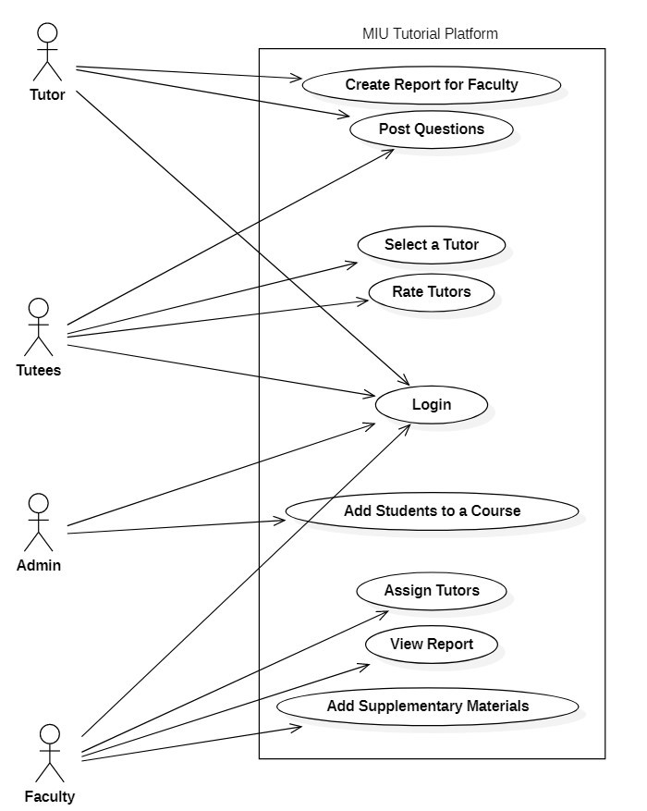
USE CASE DIAGRAM

Slide 4
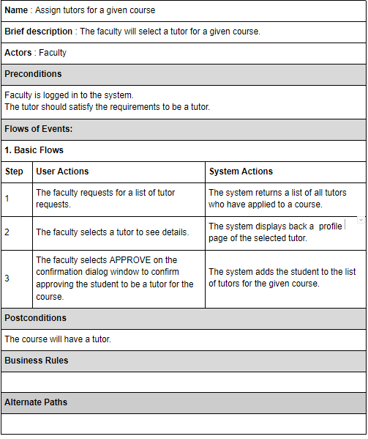
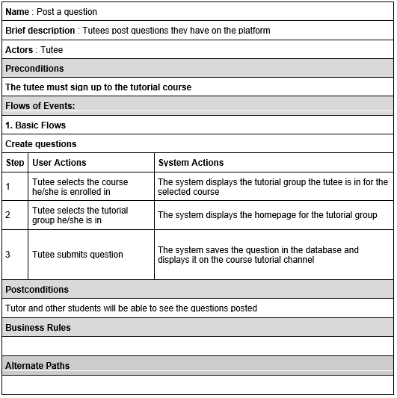
USE CASE DESCRIPTION

Slide 5
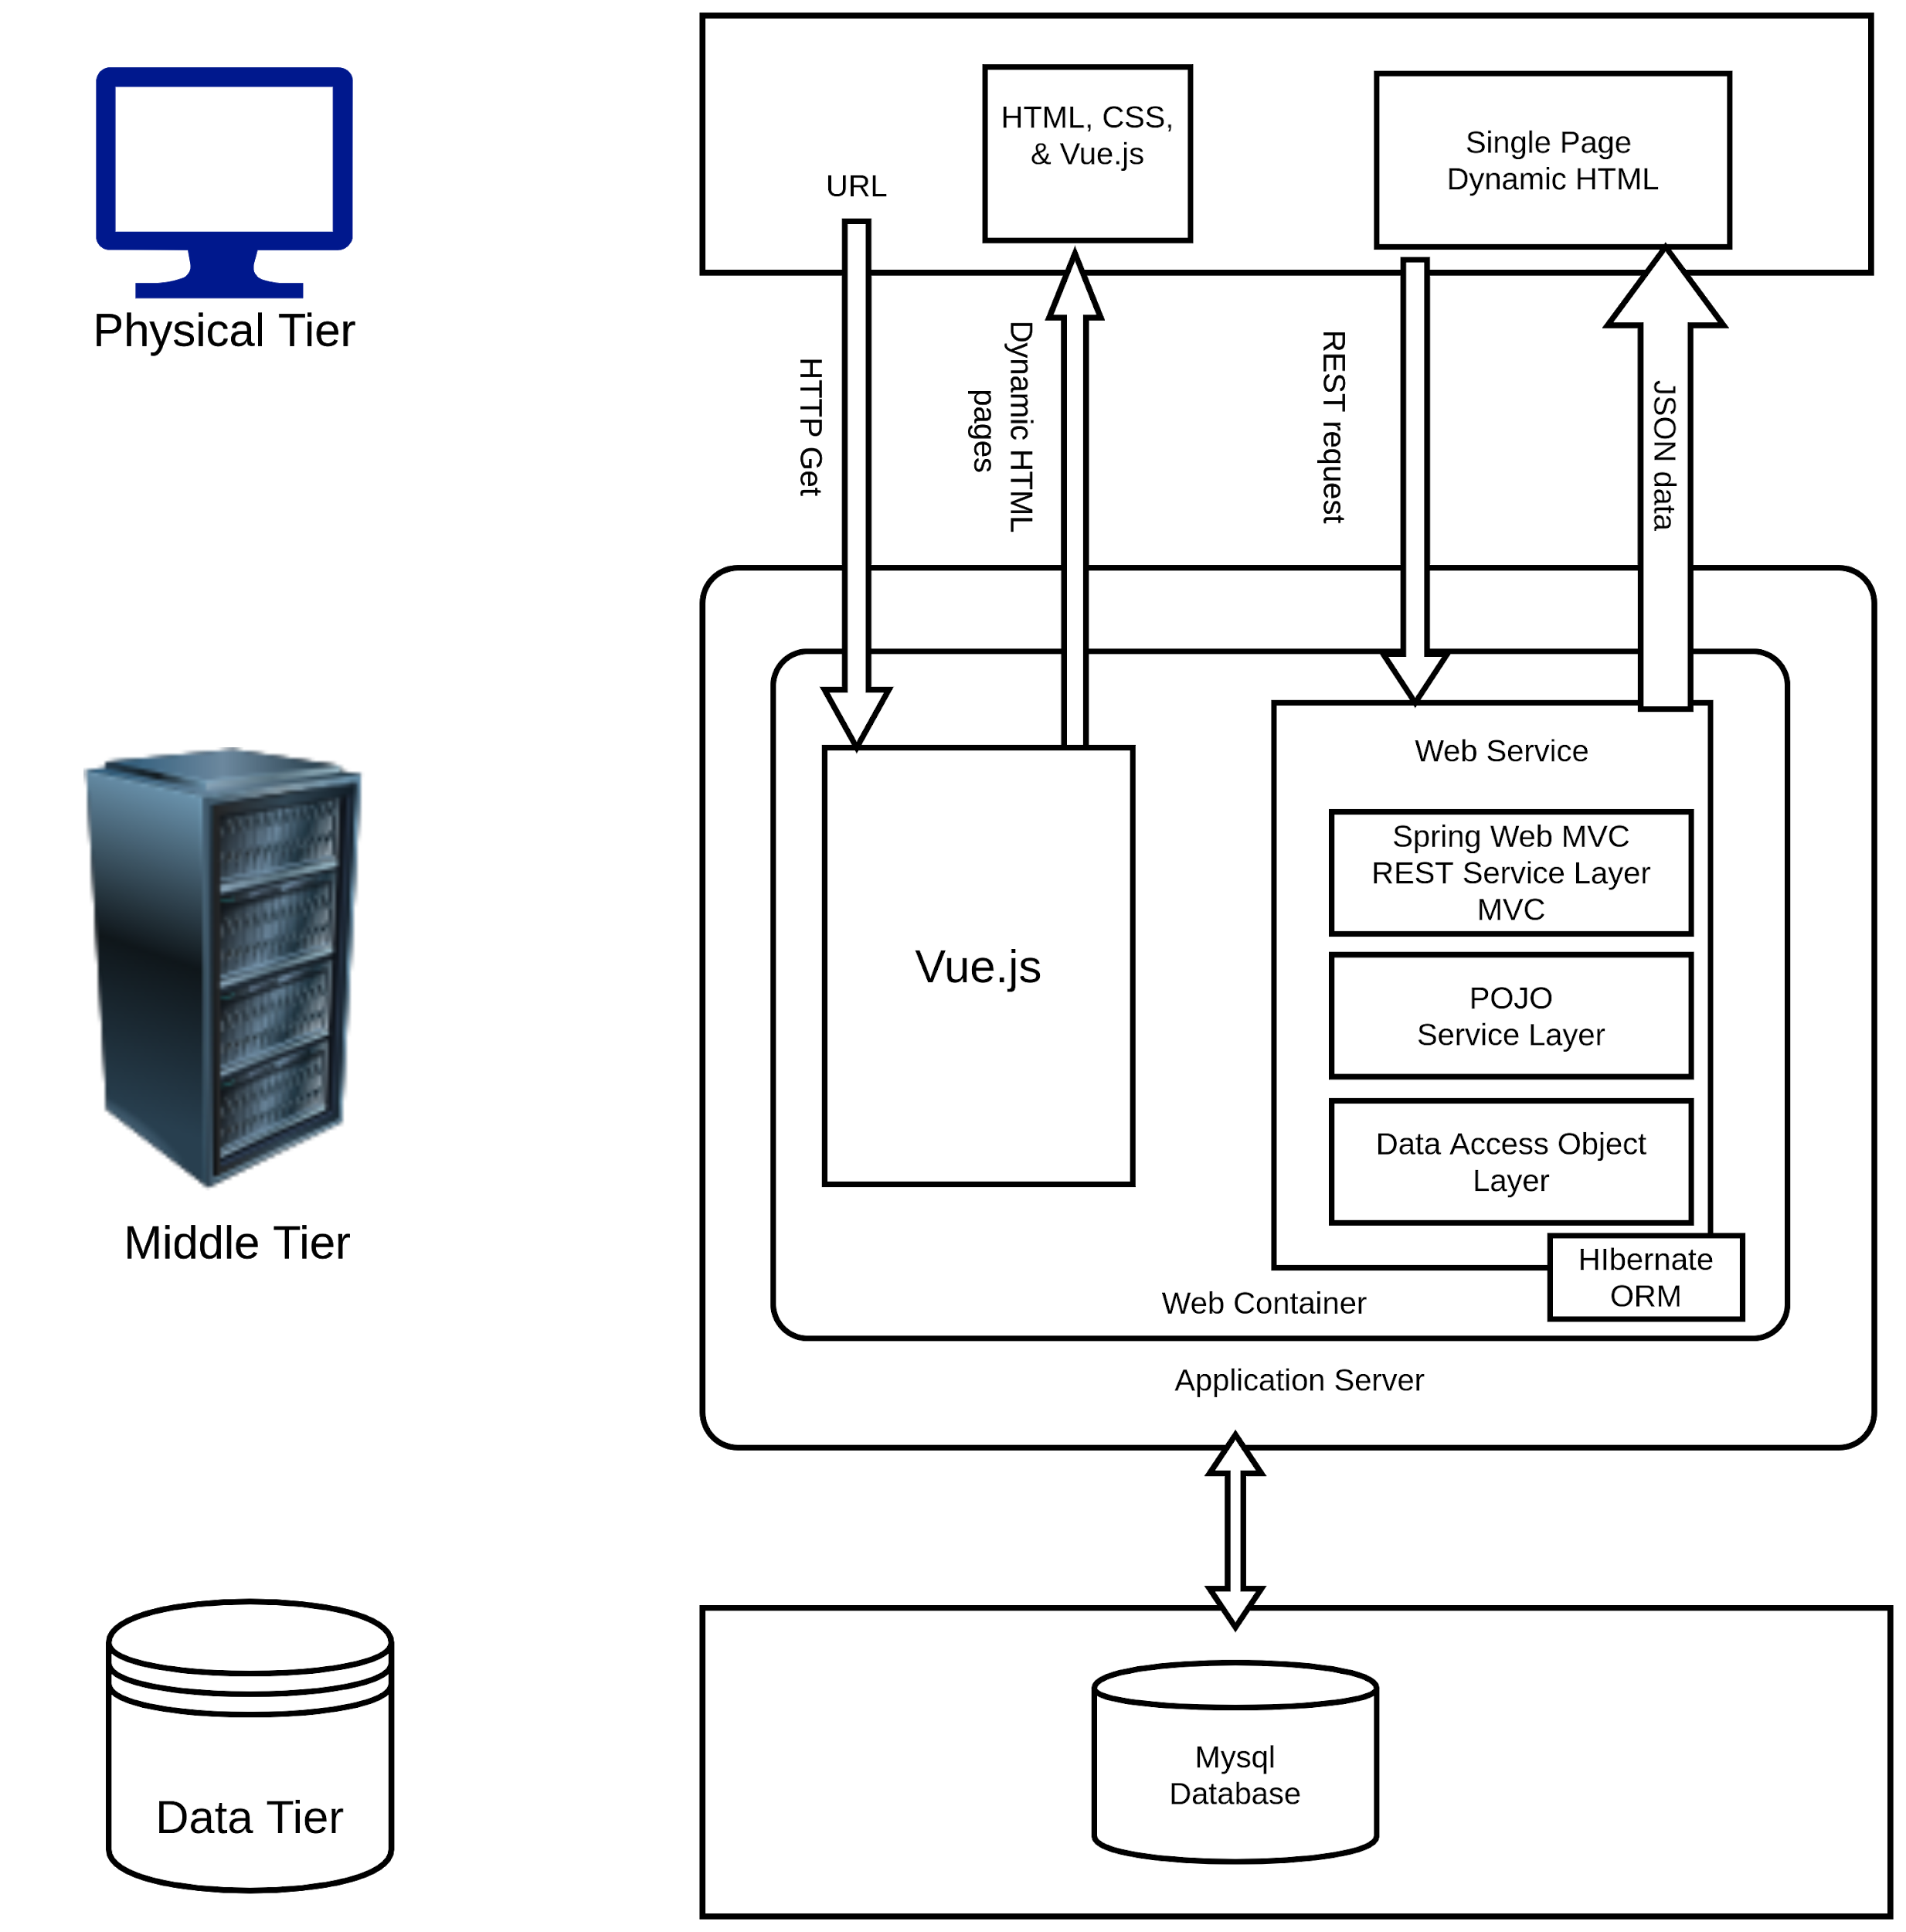
ARCHITECTURAL ANALYSIS
SYSTEM ARCHITECTURE AND
KEY ABSTRACTIONS
Student
Faculty
System Administrator
Course
Tutorial Group
Section
Post
Enrollment

Slide 6
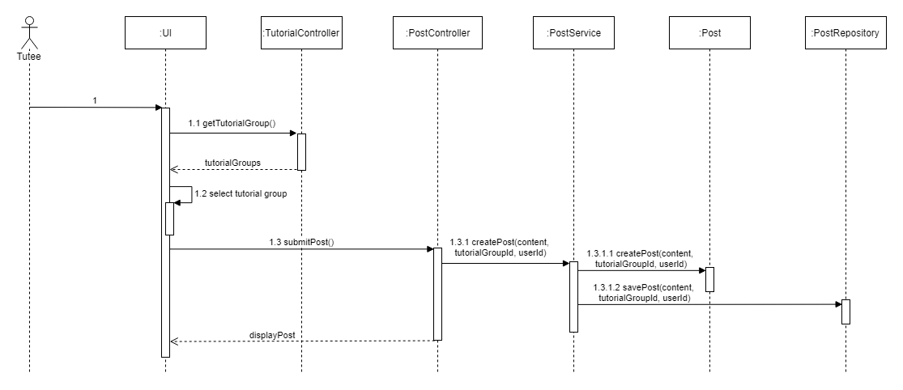
SEQUENCE DIAGRAMS - CREATE A QUESTION

Slide 7
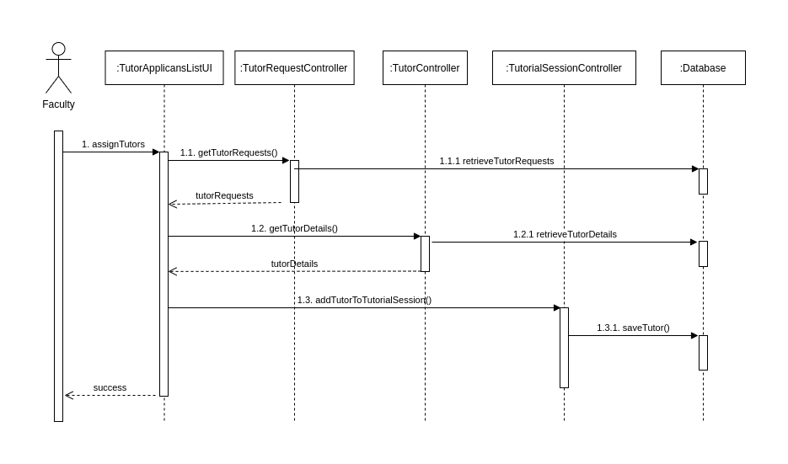
SEQUENCE DIAGRAMS - ASSIGN A TUTOR
:TutorialGroupController

Slide 8
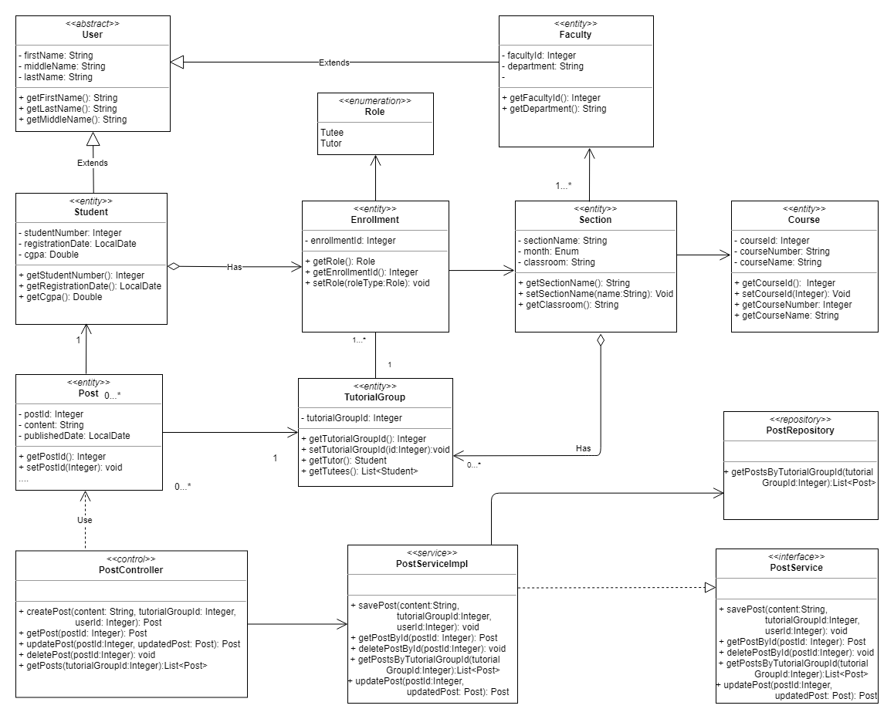
CLASS DIAGRAM - POST A QUESTION

Slide 9
THANK YOU

